Slide 1

SQL Basics and Marketing-Specific Queries
HNG Data Analysis Stage Three- HNG username(ACSP)

Slide 2
RELEVANT LINKS FOR THE TASK
https://drive.google.com/file/d/11Apo01mY8Sa32pD5e_WoRyXEojnXibxe/view?usp=sharing
https://github.com/ACSP-Tech/DATA-ANALYSIS/blob/main/HNG-3.ipynb
https://hng.tech/hire/data-analysts

Slide 3
CONTENT LAYOUT
INTRODUCTION
CONCLUSION AND OVERVIEW
Average Engagement Score
DATA CLEANING
CAMPAIGN TOTAL IMPRESSION
HIGHSET ROI CAMPAIGN
Top 3 Locations
Overall CTR (
Most Cost-Effective Campaign
CTR Above 5% Threshold
Ranking Channels

Slide 4
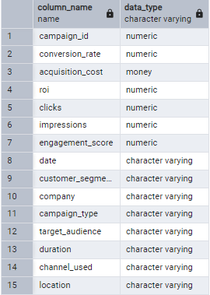
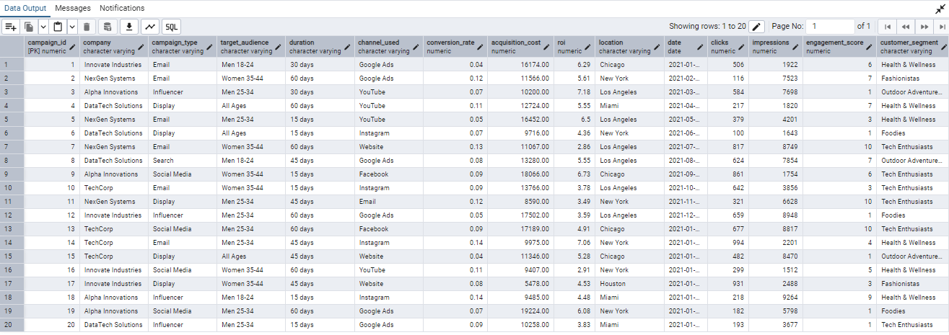
INTRODUCTION
SCHEMA BEFORE CLEANING:
Marketing Campaign Dataset
The above named was given dataset for this task.
This shape of the dataset is 200005 rows and 15 columns.
The schema as imported is given in the screenshot at the left.
The first 20 rows are been displayed in the screenshot below.
SCREENSHOT OF THE FIRST 20 ROWS OF THE DATASET:

Slide 5
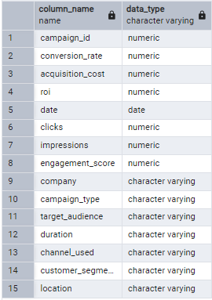
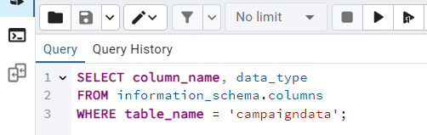
2. DATA CLEANING – DATA TYPES
SCHEMA AFTER CLEANING:
Marketing Campaign Dataset
The dataset was cleaned to make acquisition cost and date to the data type needed for the analysis.
The schema after cleaning the data types is given in the screenshot at the left.
The schema as imported is given in the screenshot at the left.
The SQL query code used to obtain the schema information is displayed in the screenshot below.
SQL query code used to obtain the schema information:

Slide 6
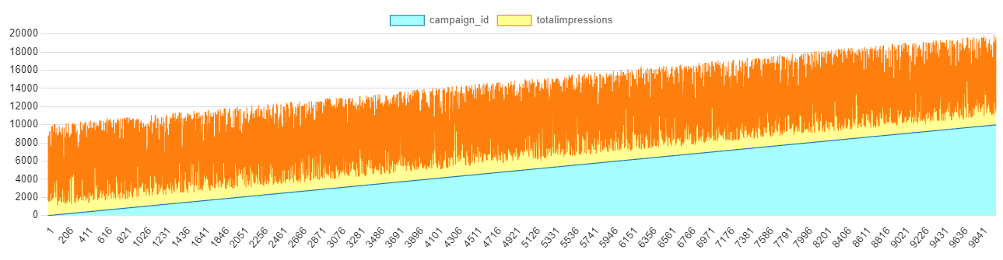
3. TOTAL IMPRESSIONS FOR EACH CAMPAIGN
Marketing Campaign Dataset
The Campaign ID is an auto-incrementing unique identifier ranging from 1 to 200,005, representing different marketing campaigns.
Each campaign has a varying number of total impressions, as shown by the orange area in the chart.
The light blue area represents the campaign ID count, which increases linearly as more campaigns are recorded.
The spikes and dips in impressions indicate that some campaigns performed significantly better or worse than others.
STACKED LINE CHART OF CAMPAIGN ID AND TOTAL IMPRESSION FOR EACH CAMPAIGN

Slide 7
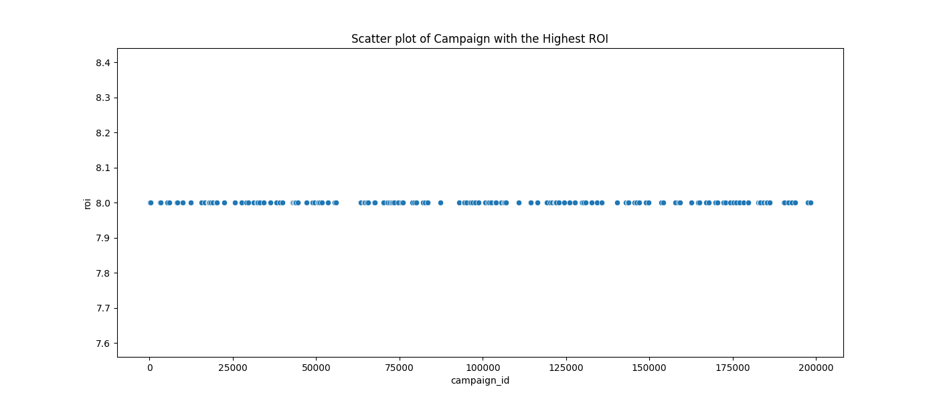
4. CAMPAIGN WITH THE HIGHEST ROI
Campaign ID - 160 Campaigns with the Highest Return on Investment.
The highest Return on Investment (ROI) is 8, achieved by a select number of campaigns.
Only 160 campaigns (0.08%) out of the total dataset attained this maximum ROI value.
A query filtering the highest ROI and limiting results to 1 returns Campaign ID 168, belonging to NexGen Systems.
The blue circle in the chart scatter plot represent the ROI values achieved by 160 different campaigns, with each campaign ID displayed on the x-axis.
The uniform distribution of the filtered results indicates that multiple campaigns share similar ROI values of 8.
Scatter plot of campaign with the highest return on Investment

Slide 8
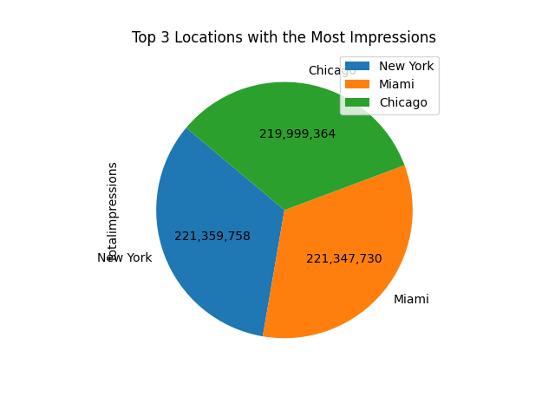
5. TOP THREE LOCATION WITH THE MOST IMPRESSIONS
Top three -New York, Miami and Chicago
The blue pie slice represents New York, which has the highest total impressions of 221,359,758.
The orange slice corresponds to Miami, with 221,347,730 impressions, ranking second.
The green slice represents Chicago, with 219,999,364 impressions, slightly lower than Miami.
The three locations account for the highest share of total impressions, indicating strong audience engagement in these regions.

Slide 9
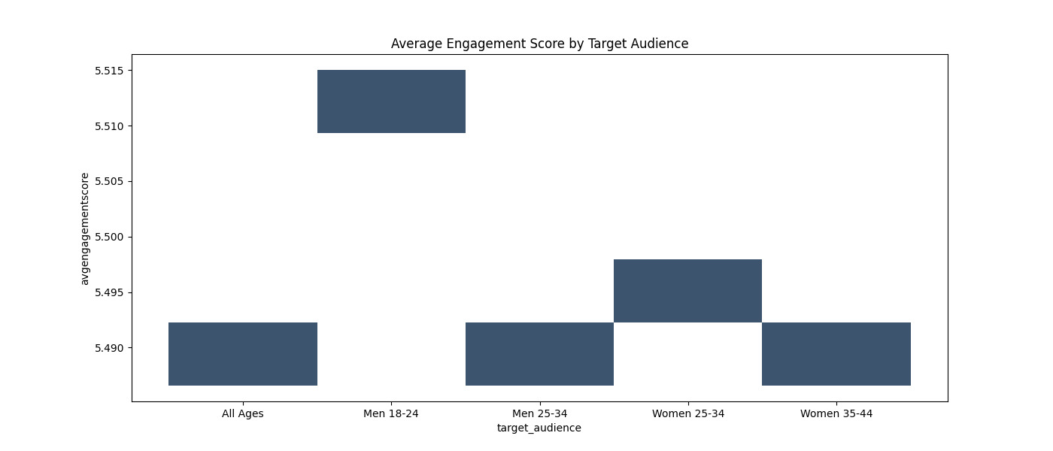
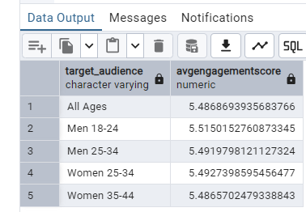
6. AVERAGE ENGAGEMENT SCORE BY TARGET AUDIENCE
The highest average engagement score is observed among Men aged 18-24 , indicating strong interaction from this demographic.
Women aged 25-34 and Men aged 25-34 show moderate engagement levels, suggesting a balanced interest from both groups..
Women aged 35-44 and the All Ages category have the lowest engagement scores, implying a relatively lower interaction rate from these segments.

Slide 10
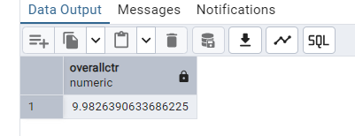
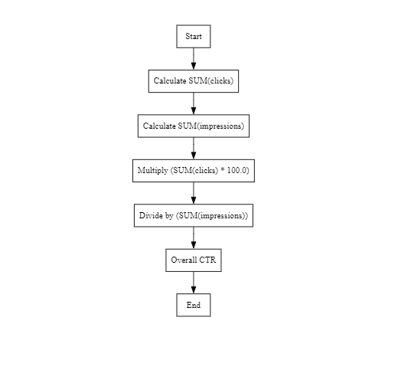
7. OVERALL CTR (Click-Through Rate)
The SQL Query execution resulted in an Overall CTR of 9.98% (from the screenshot).
Click-Through Rate (CTR) measures how effectively our ads are resonating with our target audience
This 9.98% CTR signifies that nearly 1 in 10 users who were shown our ad found it compelling enough to click and learn more.".
The flowchart shows the step by step process taken to calculate for the overall ctr.
FLOWCHART OF CALCULATION
SCREENSHOT OF OUTPUT

Slide 11
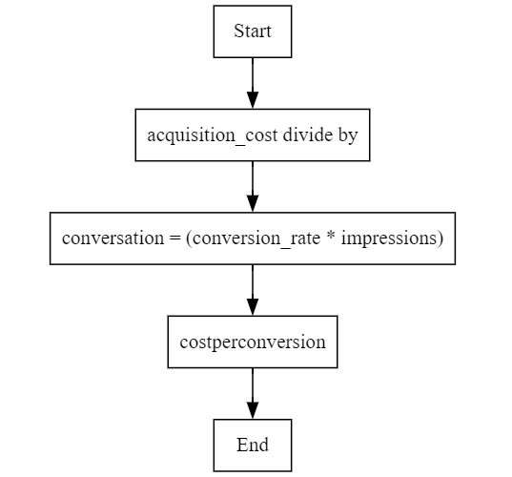
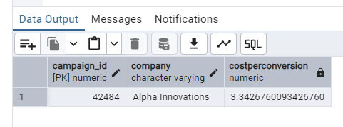
8. MOST COST-EFFECTIVE CAMPAIGN
The query result shows that campaign ID: 42484 (Alpha Innovations) has the most effective cost per conversion, which is $3.3428 approximately
Cost Per Conversion (CPC) measures the efficiency of our advertising spend by determining how much we spend to acquire a single conversion.
The lower the CPC, the better, as every organization aims to minimize cost.
Cost per Conversion is equal to Acquisition Cost divided by conversation
The conversation was calculated as shown in the flow chart.
FLOWCHART OF CPC CALCULATION
SCREENSHOT OF THE OUTPUT

Slide 12
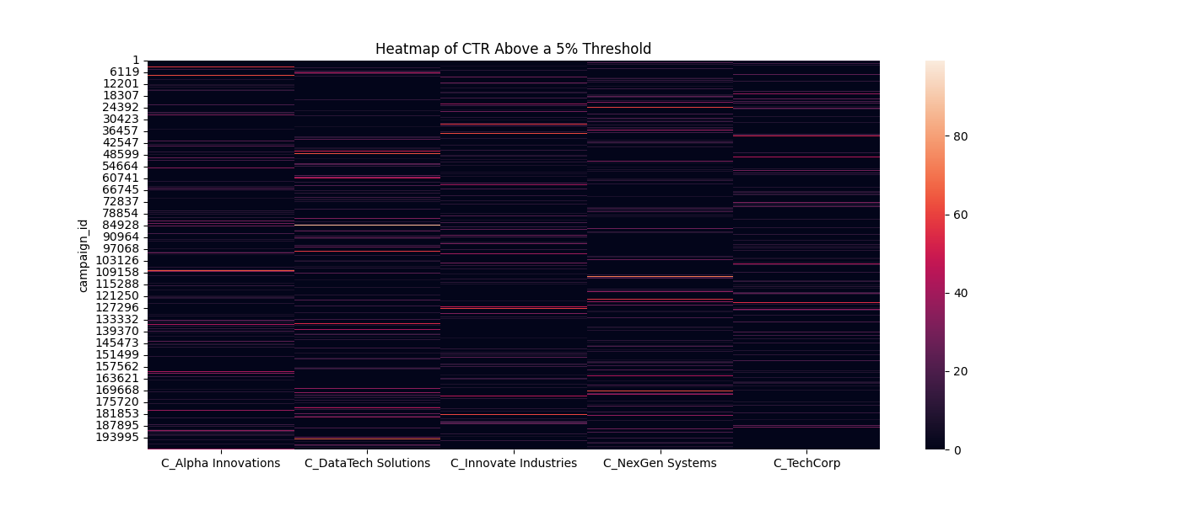
9. CAMPAIGNS WITH CTR ABOVE 5% THRESHOLD
Certain companies (e.g., C_TechCorp and C_NexGen Systems) seem to have more campaigns with high CTR values, as indicated by the brighter color patches.
Each column represents a different company on the x-axis of the heatmap.
Y-axis: Each row represents a campaign ID that had a CTR above 5%.
The values in the columns correspond to CTR values for campaigns belonging to these companies.
Darker areas (black or deep purple) indicate campaigns with relatively lower CTR values (but still above 5%).
Brighter areas (red to white) indicate campaigns with significantly higher CTR values.

Slide 13
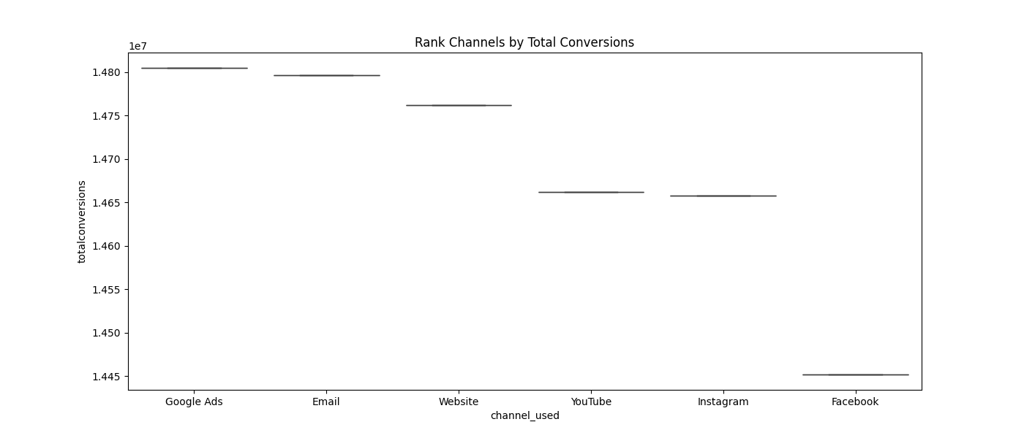
10. RANK CHANNELS BY TOTAL CONVERSIONS
Google Ads, Email, and Website have the highest total conversions, all close to 14.8 million.
X-Axis (channel_used): Represents different marketing channels.
Y-Axis (totalconversions): Represents the total number of conversions achieved through each channel.
YouTube and Instagram are still effective but slightly lagging behind with a total conversions, around 14.65 million
Facebook has the lowest total conversions, around 14.45 million.

Slide 14
11. CONCLUSION
Campaign Performance Insights
Google Ads, Email, and Website were the top-performing channels in terms of conversions.
Facebook had the lowest total conversions, suggesting room for optimization.
Engagement and ROI Trends:
The highest engagement was observed among Men aged 18-24, indicating a key demographic for future targeting.
New York, Miami, and Chicago led in total impressions, highlighting strong audience engagement in these regions.
Only 160 campaigns (0.08%) achieved the highest ROI of 8, showing that highly successful campaigns are rare.
Cost Efficiency
Alpha Innovations (Campaign ID: 42484) had the most effective Cost Per Conversion ($3.34), emphasizing efficient ad spending.
Campaigns from C_TechCorp and C_NexGen Systems had higher CTR values, making them standout performers.
Click-Through Rate (CTR) Effectiveness
An overall CTR of 9.98% indicates that nearly 1 in 10 users found the ads compelling enough to click.
Heatmap analysis revealed certain companies consistently achieved higher CTRs, signaling effective strategies worth replicating.

Slide 15
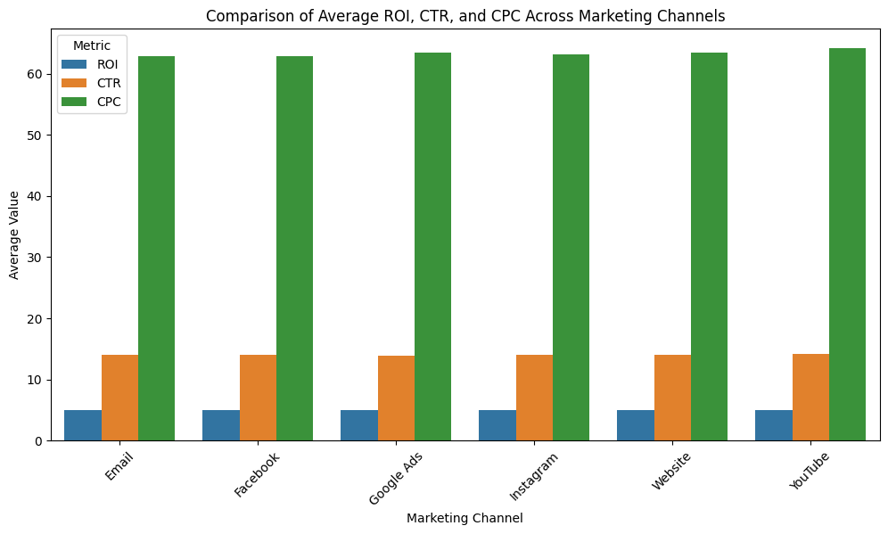
11. CONCLUSION – CONTD

Slide 16
END OF REPORT

